Slide 1

Detecting tailgating and alerting security staff
By- levi_squad

Slide 2

What is the problem we are facing?
The simple answer to this question is Tailgating.
Tailgating (also known as piggybacking) is one of the most widespread security breaches.
Tailgating can be simply described as the passage of unauthorised personnel,
either forced or accidental, behind that of an authorised user.
The problem of tailgating in large companies is prevalent and to keep this in check a lot of manual labor is required to keep the security in check.
Our problem is to detect anyone tailgating and to alert the security staff in the case of unauthorized entry.
We are going to use machine learning vision to detect anyone tailgating given a cctv footage of a secured door entry and spreadsheet containing the access-card swipe information.

Slide 3
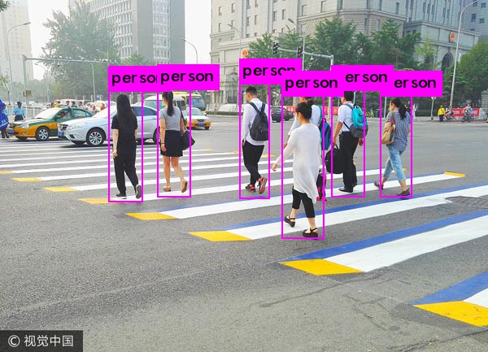
The solution we have devised..
We will use OpenCV and pre-trained computer vision models to detect and segment human from the video feed.
Our model is based on Yolov3 object detection algorithm.
After segmenting we will use the access card swipe information which contains the time of swipe, employee id and authorization result to determine if the person was tailgating or not.
This will be done by comparing the data we will get from our model for people detected and the information we already have.

Slide 4
How the solution is going to help the industry?
Our idea will help the industry by:-
Preventing unauthorized entry in classified areas.
Reducing the manpower required in security thereby reducing chances of human error.
It can also be used in different purposes like preventing unauthorized vehicle entry.
The solution can be extended to be used for other purposes of detection.

Slide 5
Closing
The source code of our solution will be available on : https://github.com/drstark007/tailgating_security_system
For more information on this project you can contact us through email:
sandeeepkumaar.0034@gmail.com

